Slide 1


Healthcare Services Projections
using
Office of Financial Planning and Analysis
October 25, 2022

Slide 2

Collaborative & Transparent Approach
The Healthcare Team
Working collaboratively will provide transparency and insightful information for departmental and University wide planning efforts.
Multi-year planning will allow us to strategically plan for economic conditions and long-range projects beyond fiscal year 2024, by using tools such as scenario analysis.
Proper planning will allow our organization to maximize opportunities and minimize potential financial risks.
Notes:
Josh

Slide 3
Overview
Healthcare Services Team
Here to Help
Why Use a Rolling Forecast?
Updating Rolling Forecast and Developing Projections
An Example: WesternU Medical Center
Notes:
Ray

Slide 4
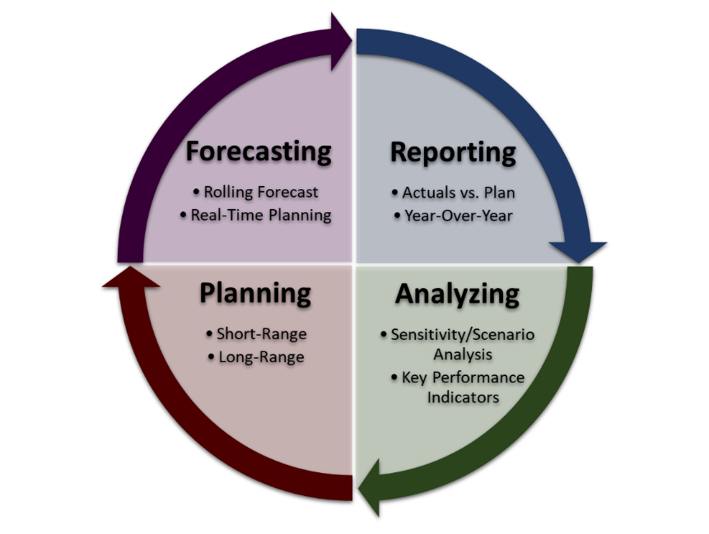
Healthcare Services Team
In collaboration with WesternU Health Administrative Team, our FP&A Team will be supporting you in the following four areas:
Notes:
Ray

Slide 5
Here to Help
WesternU Health Administrative Team
Amy Padoongpatt - Healthcare Services Operations Support (Qualitative Elements)
FP&A Team
Miguel Hernandez - Healthcare Services Planning
Office of Financial Planning & Analysis - fp&a@westernu.edu
Notes:
Amy

Slide 6
Why Use a Rolling Forecast?
Advantages of a Rolling Forecast
Accuracy in predicting budgetary needs
Driver-based functionality to integrate goal driven information
Flexibility to adjust to industry and organizational changes
Automation and ease-of-use
Decision-making tool (what-if scenarios and goal seeking)
Notes:
Amy

Slide 7
Rolling Forecast & Projections
The rolling forecast, once developed, should reflect the anticipated revenues and discounts/allowances for forward looking quarters.
Historical data is included to assist with analysis of year-over-year trends and creation of anticipated revenues.
Quantitative and qualitative information are recommended to be used for the rolling forecast for current fiscal year and upcoming fiscal year.
Quantitative
historical actuals
(statistical data)
Qualitative
assumptions
(non-statistical data)
Rolling Forecast
Notes:
Miguel

Slide 8
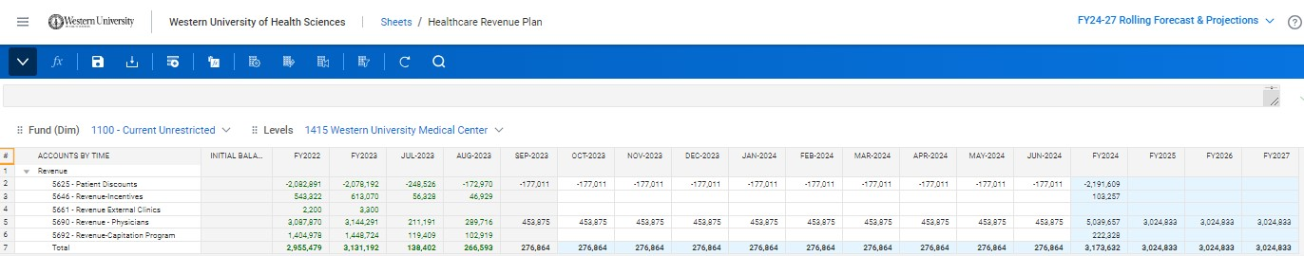
An Example: WesternU Medical Center
FYI, step-by-step instructions are available in Teams and Workday for you to reference.
Actuals will be in green font.
Q2-Q4 rolling forecast in white cells.
Projections will be showing from FY24-FY27.
Notes:
Miguel

Slide 9
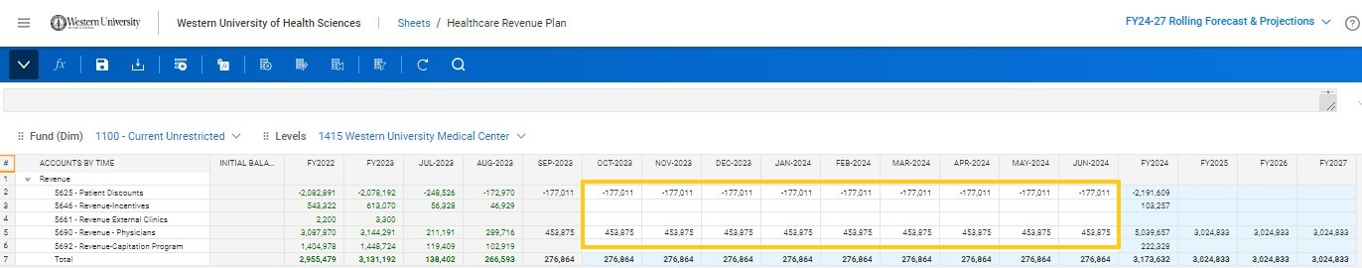
An Example: WesternU Medical Center Forecast FY24
For current fiscal year, amounts previously forecasted are shown in white cells. Please make sure to update previously developed forecast with current forecasted numbers.
All changes must be saved by clicking the Save icon.
Notes:
Miguel

Slide 10
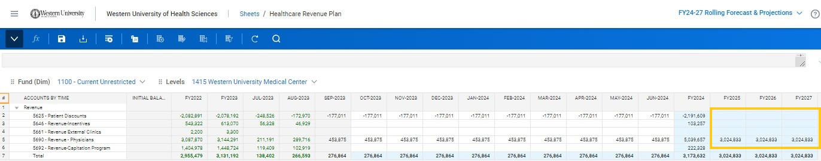
An Example: WesternU Medical Center FY24-27
For FY24-27 years, enter projected amounts directly into blue cells.
All changes must be saved by clicking the Save icon.
Notes:
Miguel

Slide 11
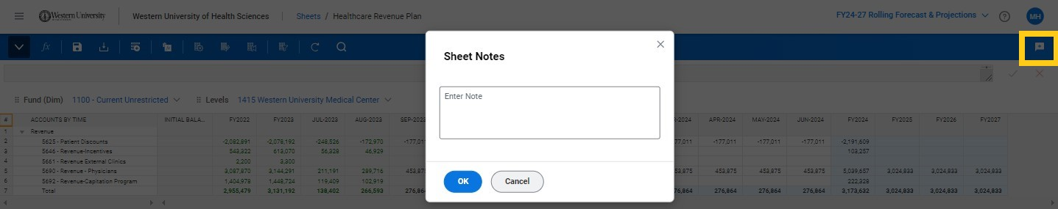
An Example: WesternU Medical Center Notes
To insert justifications as footnotes, click the sheet note icon and fill out the prompt. Click OK and then click the Save icon.
Notes:
Miguel

Slide 12
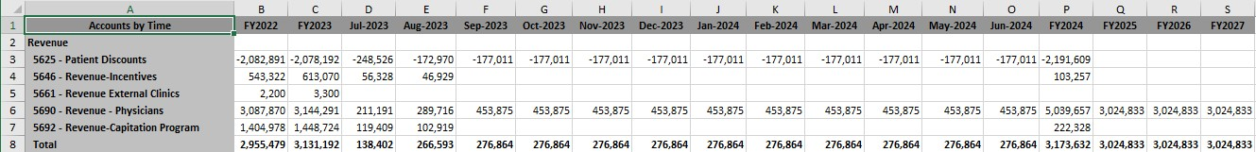
An Example: WesternU Medical Center
To view in Excel, click the download icon and open. Please note the sheet notes have also been downloaded.
Notes:
Miguel

Slide 13
Questions?
Notes:
Ray

Slide 14
Thank you!
Notes:
Ray

