Slide 1


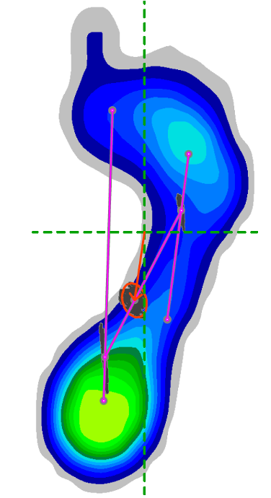
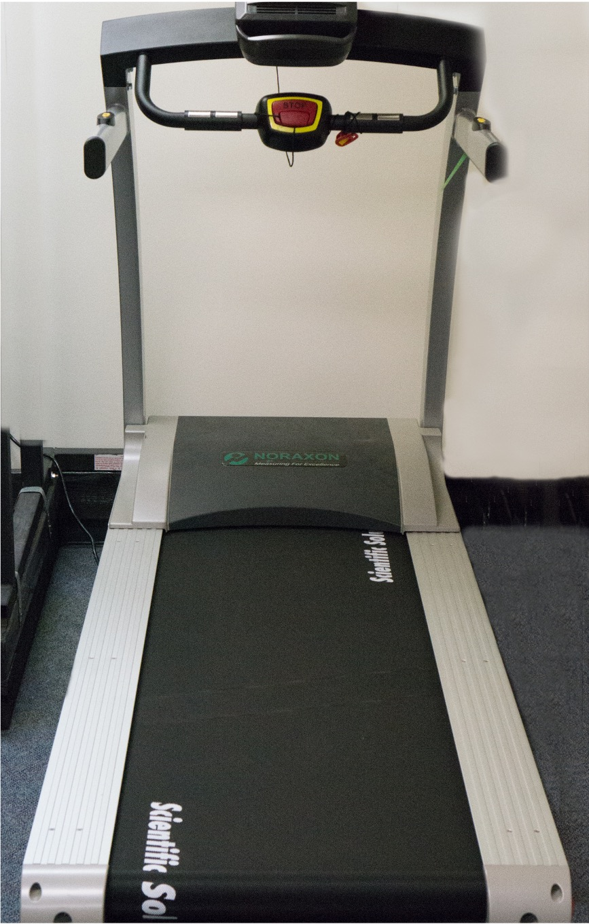
Postural Sway Differences in Individuals with Unilateral Plantar Fasciitis Versus Healthy Controls
Michael J. Granado, Everett B. Lohman III, Noha S. Daher, Keith E. Gordon
Department of Physical Therapy Education, Western University of Health Sciences
RESEARCH OBJECTIVE
RESULTS
CONCLUSION
Research Objective: To examine postural sway in the involved versus the uninvolved limb in those with unilateral plantar fasciitis (PF), as well as to compare postural sway with gender-matched healthy participants.
When examining single leg stance performance with the involved feet of the PF group, a significantly higher COP (p=0.01, effect size η2=0.9) and CEA (p=0.05, η2=0.5) was observed in comparison to healthy controls.
A similar difference was also observed when comparing COP (p=0.03, η2=0.6) and CEA (p=0.05, η2=0.1) in the uninvolved feet in the PF group with healthy controls.
When comparing the single leg stance performance of the involved versus the uninvolved feet in the PF group, no difference was observed (COP, p=0.98; CEA, p=0.38).
Individuals with PF seem to exhibit increased postural sway when compared to gender-matched healthy individuals.
This observation appears to be a global characteristic as either the involved or uninvolved foot in the PF group demonstrates this deficit.
The presence of increased postural sway in both the involved and uninvolved feet versus healthy highlights the need to further study risk factors for PF to better treat and prevent the condition.
In light of bilateral PF being a common occurrence, the specific relationship between increased postural sway and PF should be included in future studies.
METHODS
Design: Case-control comparative study.
Setting: University research laboratory.
Participants: Twenty participants with unilateral PF (mean age 47 years, 13 females) were compared between involved and uninvolved feet as well as with twenty gender-matched healthy controls (mean age 43 years, 13 females). Observers were blinded to which was the involved foot in the PF group.
Main Outcome Measures: Center of pressure (COP), 95% confidence ellipse area (CEA)
Postural Sway Plantar Fasciitis (PF) vs Control (n=20)
 | PF Group (Involved Side) [mean (SD)] | Control Group (Right Foot) [mean (SD)] | p-value | Effect Size
COP Average Velocity (mm/sec) | 35.8 (19.5) | 23.1 (5.6) | 0.01 | 0.9
95% Confidence Ellipse Area (mm²) | 602.9 (350.8) | 457.9 (149.1) | 0.05 | 0.5
 | PF Group (Uninvolved Side) [mean (SD)] | Control Group (Left Foot) [mean (SD)] | p-value | Effect Size
COP Average Velocity (mm/sec) | 35.8 (23.8) | 24.8 (5.7) | 0.03 | 0.6
95% Confidence Ellipse Area (mm²) | 640.0 (440.5) | 424.4 (112.4) | 0.05 | 0.1
Postural Sway PF Involved vs PF Uninvolved (n=20)
 | PF Group (Involved Side) [mean (SD)] | PF Group (Uninvolved Side) [mean (SD)] | p-value
COP Average Velocity (mm/sec) | 35.8 (19.5) | 35.8 (23.8) | 0.98
95% Confidence Ellipse Area (mm²) | 602.9 (350.8) | 640.0 (440.5) | 0.38
ACKNOWLEDGEMENTS & CONTACT
Special thanks to the Department of Physical Therapy at Loma Linda University
For more information contact:
Dr. Michael J. Granado
(909) 469-5311
mgranado@westernu.edu

