Slide 1
College of Graduate Nursing Emergency Nurse Practitioner Certificate Welcome Week Orientation August 2019

Slide 2
Agenda
Welcome & Introductions
Getting Acquainted
ENP Overview
Program Expectations
ENP Professional Standards –SOP & Clinical Practice Sites
Course curriculum, SWs, Procedural Skills
ENP Grand Rounds
Technology Overview
Bb/e-Logs & clinical hours
ENP Scholarship Requirement:
Multiple Choice Examinations
Rosh Review Online National Certification Review
ENP Faculty & Team Support
Questions, Evaluation & Next Steps

Slide 3
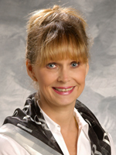
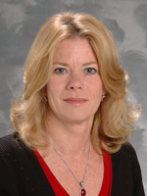
Introductions
Dr. Donna Emanuele, DNP, RN, CNS, FNP-BC, FAANP
Director, ENP Post Graduate Certificate
Dr. Christine Magladry, DNP, RN, FNP-BC
Course Developer, Lead Faculty and ENP Clinical Coordinator

Slide 4
Introductions
Each person introduce yourself (10 minutes)
Personal information you want to share
Where you work, your specialty
Why you are pursuing the ENP post graduate certificate
Discuss with colleagues and faculty

Slide 5
ENP Post Graduate Certificate Leadership
Donna M. Emanuele, DNP, CNS, FNP-BC, FAANP
Associate Professor
Director DNP Program and ENP Post Graduate Certificate
Christine Magladry, DNP, RN, FNP-BC
Assistant Professor
ENP Post Graduate Certificate Faculty &
Clinical Coordinator ;
DNP Faculty

Slide 6
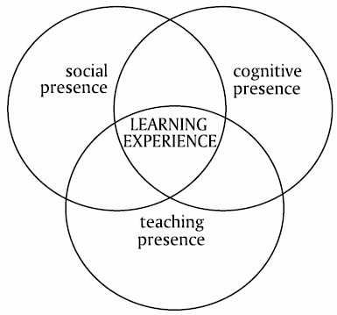
Community Of Inquiry Framework
Swan, K. P., Richardson, J. C., Ice, P., Garrison, D. R., Cleveland-innes, M., & Arbaugh, J. B. (2008).Validating A measurement tool of presence in online communities of inquiry. E-mentor, 2(24). www.E-mentor.Edu.Pl/Eng

Slide 7
Parallel/Complementary Learning Arenas
Procedural Skills/National Cert. Review
Clinical Experience
Courses/ ENP Grand Rounds/Testing

Slide 8
Perfection or Excellence? (Zenger Miller)
Perfection is being right.
Perfection is fear.
Perfection is anger and frustration.
Perfection is control.
Perfection is judgment.
Perfection is taking.
Perfection is doubt.
Perfection is pressure.
Perfection is the destination.
Excellence is willing to be wrong.
Excellence is taking a risk.
Excellence is powerful.
Excellence is spontaneous.
Excellence is accepting.
Excellence is giving.
Excellence is confidence.
Excellence is natural.
Excellence is the journey.

Slide 9
Fall | Spring | Skills
Semester 1-Fall 2019 |  | Procedures
Weekly ROS content review ENP Grand Rounds (4) Multiple choice examination (end of semester) Seminar Weekend attendance procedural skills Clinical hours: Urgent Care (90) |  | November 15, 2019 Houston, Texas
Semester 2-Spring 2020 |  | Procedures
Weekly ROS content review ENP Grand Rounds (4) National certification review and exit examination (end of semester) Seminar Weekend attendance procedural skills Clinical Hours: Emergency Dept. (180) |  | February 16, 2020 Pomona Campus
What’s Ahead
White coat ceremony
2-semesters of courses (Fall & Spring)
Objective Testing
Clinical Hours ( hrs total 270 UC/ED)
Procedural skills training
National cert. review
Certificate granted!

Slide 10
Procedural Skills
Fall Semester 1
Barkley & Associates Procedural Skills Part I | SW Houston, TX 2019
Spring Semester 2
Pomona Campus: Procedural Skill Part II | SW February 2020
Regarding ENP Procedural Skills Sessions
. This will be a live hands on MANDATORY clinical practice experience for ENP students
Fall 2019: 07:45 – 17:00 Class procedural skills I
Spring 2020: 07:45 – 1700 Class procedural skills II

Slide 11
Questions?
Donna M. Emanuele, DNP, FNP-BC, FAANP
Associate Professor
ENP Certificate Director
demanuele@westernu.edu
818-419-2778
Chris Magladry, DNP, RN, FNP-BC
Assistant Professor
ENP Course Developer, Lead Faculty and Clinical Coordinator
magladryc@westernu.edu
(909) 469-5580
Practice Affiliations Approvals
Jenny Castro and Kelley Montz
College of Graduate Nursing Western University of Health Sciences
kmontz@westernu.edu
Jlcastro@westernu.edu

