Slide 1
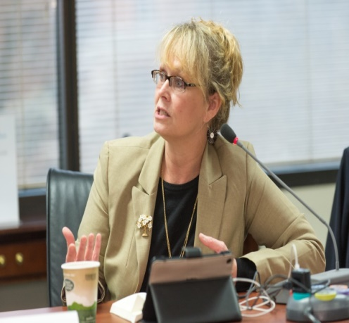
The Doctor of Nursing Practice
Reflections and
Reflective Practice
of a DNP Scholar
Donna M. Emanuele, DNP, FNP-BC,ENP-C FAANP
Associate Professor of Nursing
DNP Program Director
Western University of Health Sciences

Slide 2
“There is no greater agony than bearing an untold story inside you.”
Maya Angelou

Slide 3
DNP
Reflective Thinking

Slide 4
Reflective Thinking Is
Thinking that is purposeful and working towards a conclusion
Reflection begins with an unexpected difficulty, challenge or problem (Dewey)
Where the thinker examines the sources of, and evidence supporting, a set of beliefs or expectations surrounding a situation, and to search and inquire in an effort to resolve doubt (Musolino & Mostrom, 2005).

Slide 5
Reflective Thinking

Slide 6
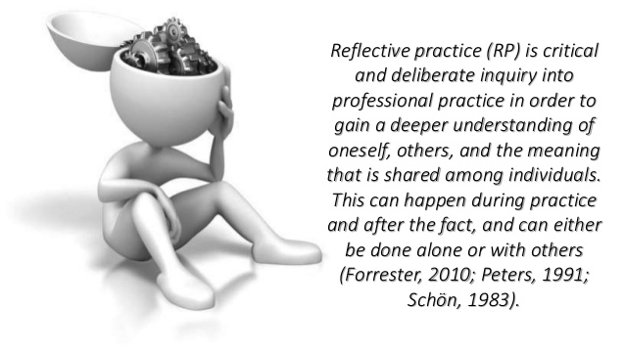
DNP
Reflective Practice

Slide 7
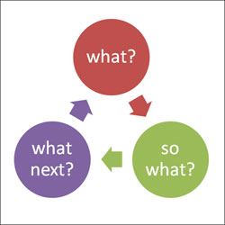
What is Reflective Practice
Part of a change that acknowledges the need for students to act and to think professionally as an integral part of learning throughout their courses of study, integrating theory and practice from the outset (Mann, Gordon, & MacLeod, 2009)
Helps close the gap between
theory and practice
(Working in Partnership Programme, 2006)

Slide 8
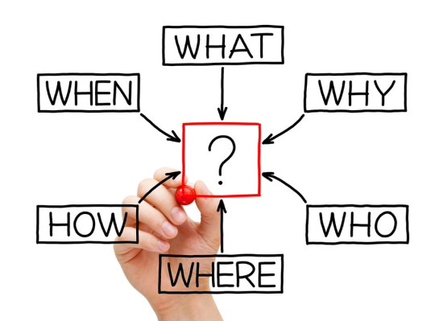
Reflective Practice
Donald Schon (1983)
Expanded on theory of reflection
Developed concept of Reflective Practice
Improving clinical practice and consequently quality of care, through exploring and evaluating one’s understanding of a problem rather than simply trying to solve it (Leung, Pluye, Grad, & Weston, 2010)

Slide 9
DNP Scholars & Reflection
“to see things from a different perspective and then gain insight that makes it an effective learning experience”(Ashby, 2006, p. 37).

Slide 10
Kolb’s Experiential Learning Cycle, 1984

Slide 11
Gibb’s Reflective Cycle, 1988

Slide 12
How Do You Build Your DNP Toolbox?
Time
Reflection & Professional Development Plan
Clarification
Validation
Analysis
Application
Dissemination

Slide 13
Student Learner to DNP Scholar

Slide 14
Essential Attributes “Tools”
Learn from one’s experiences
Develop & maintain competence over a practice lifetime
Identify your learning needs
Present application of skills and competencies
Professional identify development
Understanding your personal values, beliefs, & attitudes within your professional culture (and the world around you)
Linking new to existing knowledge
Becoming more self-aware to engage in self-monitoring and self-regulation
Mann, Gordon, & MacLeod, 2009

Slide 15
Where are you going? Where do you begin?
Being a good DNP scholar involves more than “merely” coming up with brilliant ideas & implementing them.
Most scholars spend a majority of their time reading papers, discussing ideas with colleagues, writing & revising papers, staring blankly into space -- and, of course, having brilliant ideas and implementing them.

Slide 16
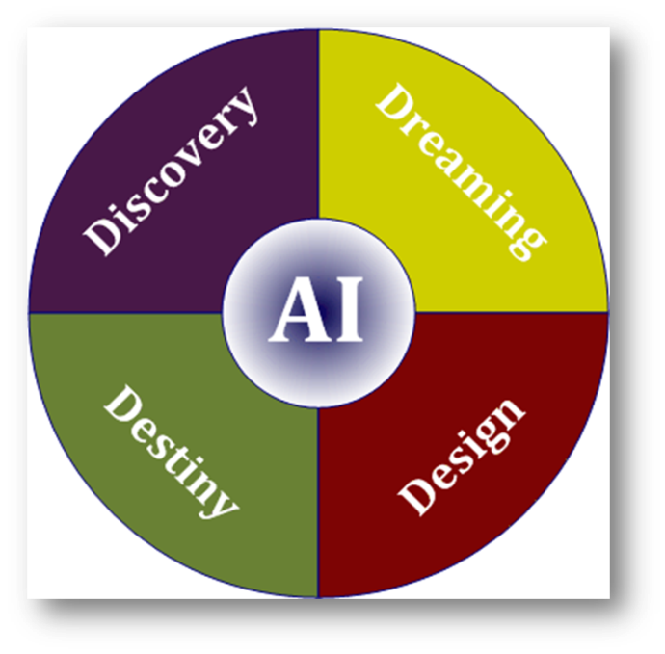
Appreciative Leadership
DNP
Appreciative Inquiry

Slide 17
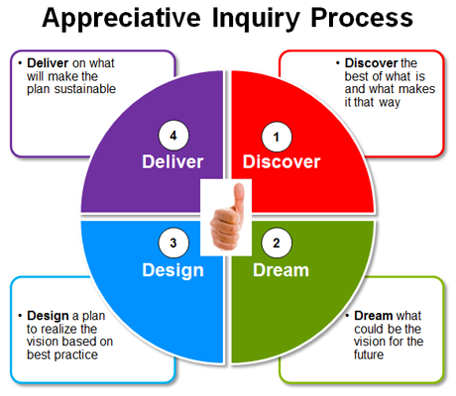

Slide 18
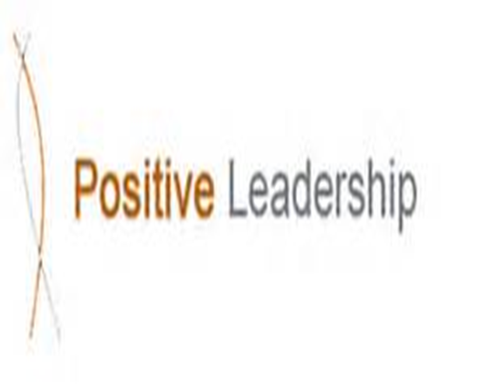
As DNP Scholars

Slide 19
“Those who say it cannot be done should not interrupt those doing it.”
Author unknown

Slide 20
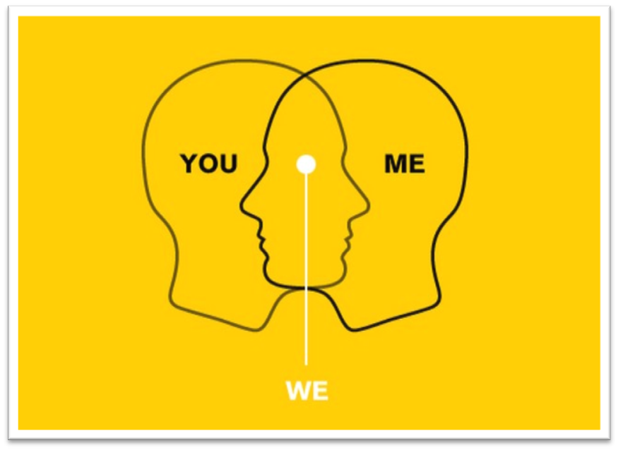
DNP
Appreciative Leadership

Slide 21
Paradigm Shift in Leadership
Appreciative Leadership (AL) is “the relational capacity to mobilize creative potential and turn it into positive power—to set in motion positive ripples of confidence, energy, enthusiasm, and performance—to make a positive difference in the world.” (Whitney, 2010)

Slide 22
Four Formative Ideas to AL (Whitney, 2010)
It involves relational processes and practices through which people come together and make things happen collaboratively.
It is a positive worldview, based on the belief that every person, team and organization has positive potential.
It recognizes potential and seeks to turn it into positive power; that is life-affirming results.
It creates waves of positive change rippling outward.
**focus on learning what is working rather than what is wrong in the practice environment and build upon that

Slide 23
5-Areas of Relational Practice(Whitney, 2010)
Different needs that people have for high performance:
Inquiry: people need to know they belong.
Illumination: people need to feel valued for what they have to contribute.
Inclusion: people need to know where the organization or community is headed.
Inspiration: people need to know that excellence is expected and can be depended on.
Integrity: people need to know that they are contributing to the greater good.
**Different strategies for different needs
Source: http://positivechange.org/five-strategies-of-appreciative-leadership/

Slide 24
EI and DNP Scholars
Self Awareness
Awareness of Others
Self Management
Relationship Management

Slide 25
Asking the Right Questions
Winning Performance
Thriving Outcomes

Slide 26
Becoming a DNP Scholar means…
Becoming part of a
larger scholarship
Community

Slide 27
Planning and Structuring the DNP Scholarly Project

Slide 28
What is a DNP Scholarly Project?
Builds upon student expertise through practice inquiry:
“Practice Inquiry is an ongoing, systematic investigation of questions about nursing therapeutics and clinical phenomena with the intent to appraise and translate all forms of ‘best evidence’ to practice, and to evaluate the translational impact on the quality of health care and health outcomes.” (Magyary, Whitney & Brown, 2006, p. 143)
“The DNP focuses on providing leadership for evidence‐based practice.
This requires competence in translating research in practice, evaluating evidence, applying research in decision‐making, and implementing viable clinical innovations to change practice.” (AACN DNP FAQs, updated 2009).
Magyary, D., Whitney, J. , & Brown, M.A. (2006). Advancing practice inquiry: Research foundations Doctor of Nursing Practice. Nursing Outlook, 54(3), 139‐142.

Slide 29
Areas of DNP Practice Inquiry
DNP practitioner focus
Translational science | Science of improvement
Program evaluation
Practice change (improvement) programs
Quality improvement
Translating evidence to clinical practice
AACN DNP Task Force, 2006.
Source: AACN. DNP Implementation Task Force http://www.aacn.nche.edu/aacn-publications/white-papers/DNP-Implementation-TF-Report-8-15.pdf
Brown, M. A. (2011). Advancing Practice Through the DNP Capstone [PowerPoint]. Washington, D.C.: AACN

Slide 30
Scholarly Project Deliverables
Demonstrates synthesis of the student’s work and lays the foundation for future scholarship
Produces a tangible and deliverable academic product
Derived from the practice immersion experience
Documents outcomes of student’s educational experiences
Provides a measurable medium for evaluating immersion experience
Summarizes student’s growth in knowledge and expertise
Brown, M. A. (2011). Advancing Practice Through the DNP Capstone [PowerPoint]. Washington, D.C.: AACN

Slide 31
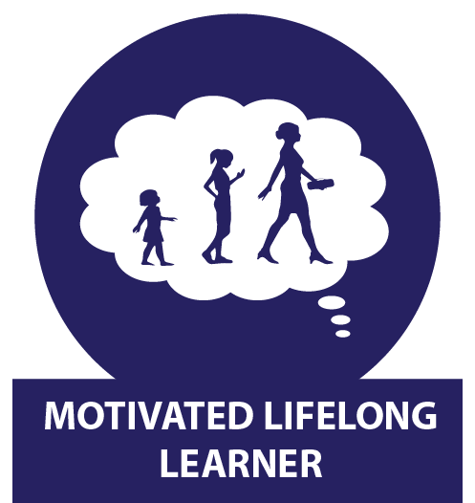
Tips & Strategies
Staying Motivated
We all suffer from insecurity, anxiety, and even boredom
Be realistic about what you can accomplish, and try to concentrate on giving yourself positive feedback for tasks you do complete, instead of negative feedback for those you don't

Slide 32
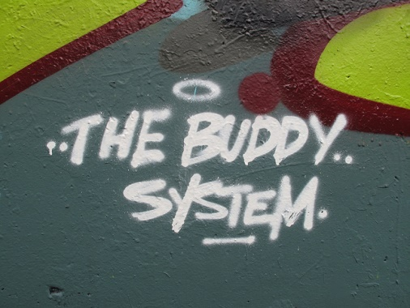
Tips & Strategies
Time Management is Key
Stay focused
Organize activities to force you to manage your time and to do something every day
Setting daily, weekly, and monthly goals
Use a “buddy system” where you and another student meet/talk regularly
Find people to work with

Slide 33
Tips & Strategies
Allocate enough time to ‘decide’ on your topic
Match your particular niche
Decide on a topic which you already have some knowledge of or one you are ‘passionate’ about
The topic should keep you motivated over a 2-year period

Slide 34
Organizing for Success
Early Identification of Problem
Turning preliminary thoughts into a scholarly concept
Formulating a practice question
Good questions cannot be posed without knowledge of what researchers already know
What does the evidence say?

Slide 35
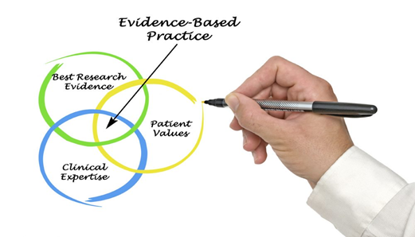
Organizing for Success
Understand the Research Process
ROL (critical /analytical appraisal of the theoretical/empirical literature)
the first step in posing a question worth answering is reviewing the literature on the topic
Methodology
Findings/Results
Summary/Conclusions
Implications/Discussion

Slide 36
Organizing for Success
Understand how a manuscript is written
Basic format and writing style (APA 7th ed.)
Written guidelines to supplement format (university specific)
Length
Expect numerous revisions to the DNP Scholarly Project
Access LEAD early and often

Slide 37
Organizing for Success
Divide-and-conquer strategy on writing
Breaking down any project into smaller pieces is always a good tactic when things seem unmanageable
Instead of writing an entire manuscript, focus on the goal of writing a chapter, section, or outline
Identify tasks that you can do in an hour or less; then you can come up with a realistic daily schedule

Slide 38
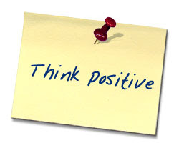
Organizing for Success
Social & Academic Support
Involve and use your mentors
Discussions with your mentors help generate ideas for your DNP Scholarly Project and may steer you towards more interesting approaches
Talk to your peers
Engage the right resources
Surround yourself with Positive People

Slide 39
Organizing for Success
Work with your DNP Project Team-Advisor
Guides you to attain goals
Schedule of tasks and accomplishments: prospectus-proposal to final project
Timetable of due dates
IRB approval
Seek their counsel to effective DNP Scholarly Project
Help & advisement
Use them to your advantage
Understand students’, advisors’, and committee members’ responsibilities

Slide 40
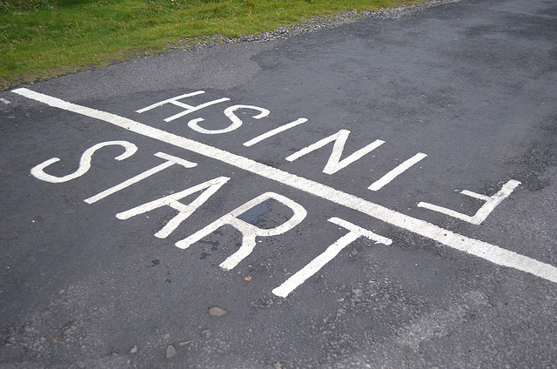
Remember…
Every task you complete gets you closer to the finish line

Slide 41
Recap…
Planning
Structuring the DNP Scholarly Project
Time Management
Writing
Staying Motivated
Social & Academic Support
Dissemination and Presentation

Slide 42
The Four Agreements, 1997
Be Impeccable With Your Word
Don’t Take Anything Personally
Don’t Make Any Assumptions
Always Do Your Best

Slide 43
Final Thoughts….
“love life, engage in it, give it all you've got. love it with a passion, because life truly does give back, many times over, what you put into it”
Maya Angelou

