Slide 1
Intergenerational Issues:
Mastering the Mix
Tim Wood, DHSc, PA-C
Director, CAPE
Assistant Professor, Dept of PA Education

Slide 2
Learning Objectives
List the different characteristics of the generations
Describe the seven characteristics of Millennials
List strategies for interacting with Millennials in the classroom to minimize conflict and maximize learning

Slide 3
Notes:
We see conflict just about everyday. In the workplace, and in the classroom.
Animation #1 – most of the time it can be unspoken
Animation #2 – there are times that it escalates to verbal
Animation #3 – but in our minds it probably feels like this
Much of the time conflict is based on the difference between differing priorities of the participants involved.
The difference between expectations and performance manifests itself as conflict.
A factor regarding

Slide 4
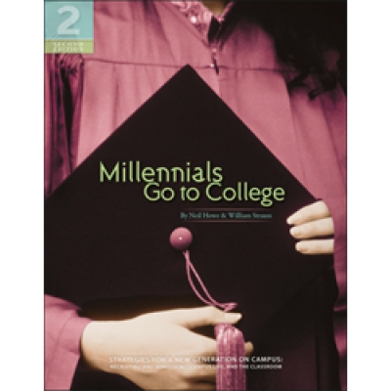
Neil Howe &
William Strauss
(2007)
Notes:
Strauss and Howe are considered two of the more prominent researchers when it comes to “generational” cohorts. They started to discuss the “millennials back in 2000, but their work “Millennials Go to College” has filled a void for educators looking to find out why there seems to be a “disconnect” in the classroom and to fill in details on these alien beings.

Slide 5
Conflict in the classroom and workplace is
often driven by generational differences
Notes:
Much of the time conflict is based on the difference between differing priorities of the participants involved.
The difference between expectations and performance manifests itself as conflict.

Slide 6
First time that there are four generations are together in the workplace and classroom
*Veterans
*Baby Boomers
*Gen X (Xers)
*Millennials
(Gen Y)
Notes:
Generations cover a roughly 20 year period each – enough time for the cohort to reach sexual matuirity and independence and begin to start their own family units.

Slide 7
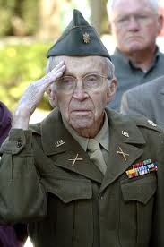
Veterans accusation of baby boomers
You’re
ANTI-ESTABLISHMENT
(Madell, n.d.)

Slide 8
Boomers accusation of Xers
You’re a
SLACKER!
(Madell, n.d.)
Notes:
Different theories on the name. Robert Capa, British photographer captured images of

Slide 9
Xers accusation of Millennials
Entitled DIVA!
(Madell, n.d.)

Slide 10
Millennials say....
But we
ARE
SPECIAL!

Slide 11
Table Activity
Name three traits of the millennial generation.
What are the traits of millennials that you are finding problematic in the classroom?

Slide 12
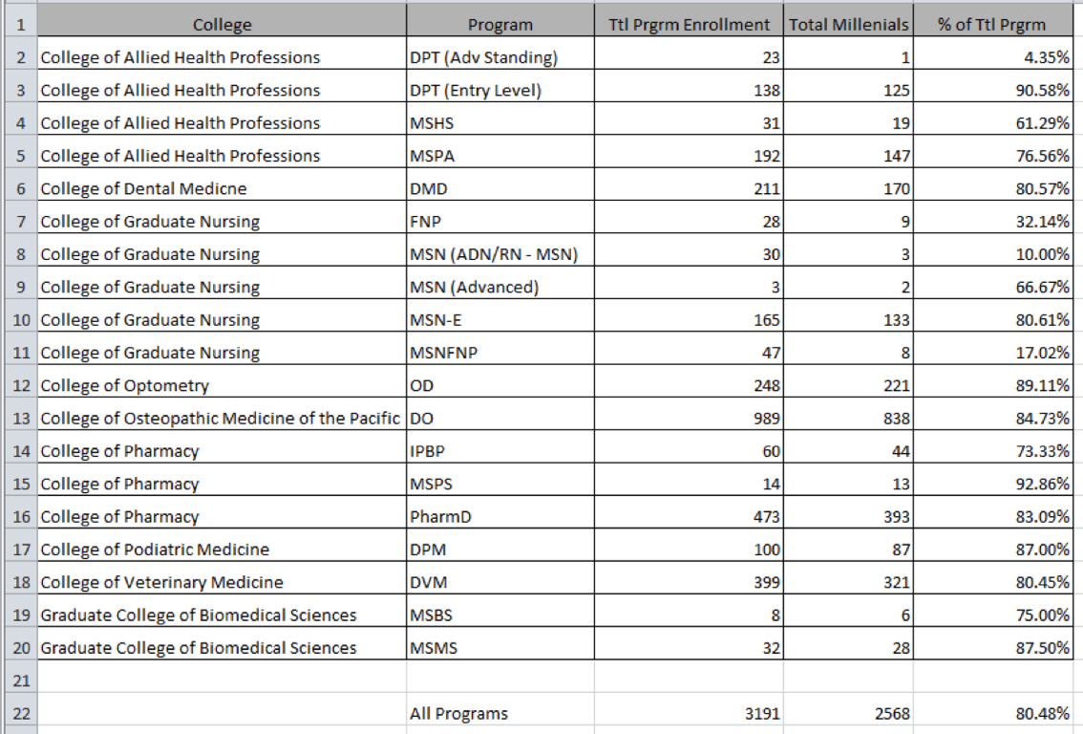

Slide 13
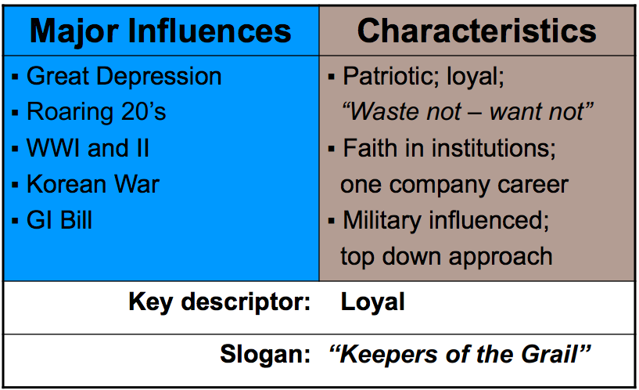
Veterans 1900-1945
(Trower, 2009)

Slide 14
Baby Boomers 1946-1960
(Trower, 2009)

Slide 15
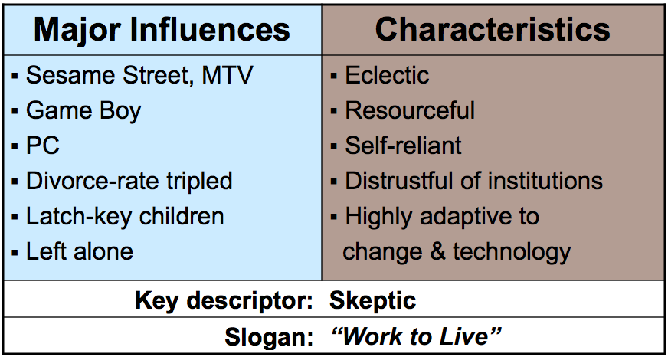
Generation X 1961-1980
(Trower, 2009)

Slide 16
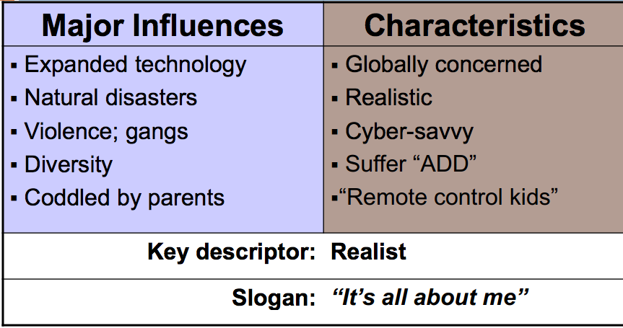
Millennials 1980 - 2000
(Trower, 2009)

Slide 17
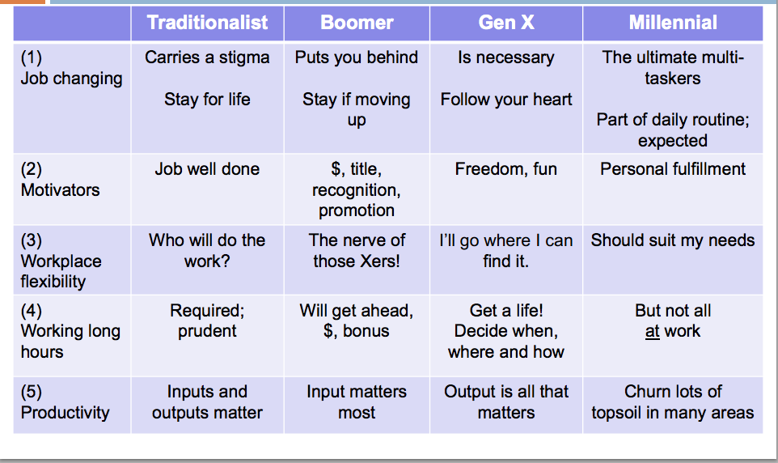
The conflicts....
(Trower, 2009)

Slide 18
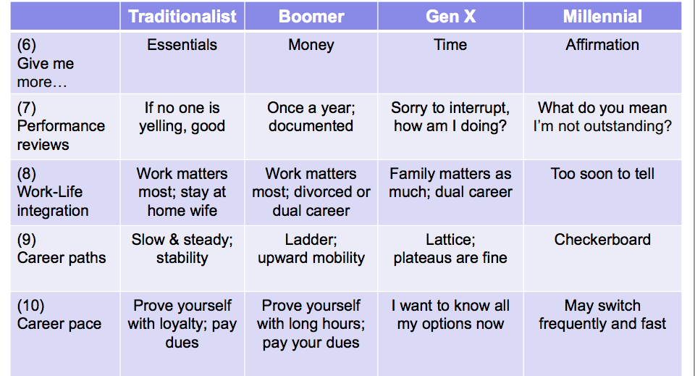
(Trower, 2009)

Slide 19
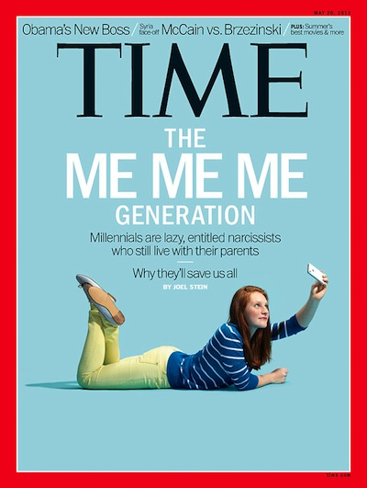
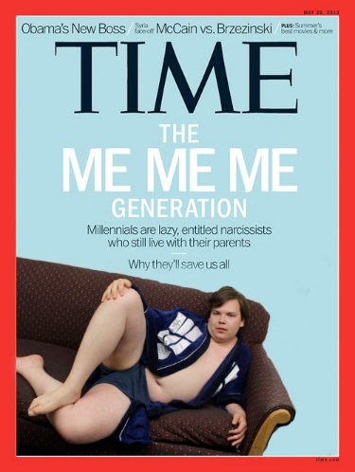
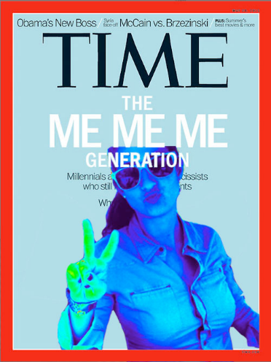
Most of the heat and attention these days is on the millennials
Notes:
Joel Stein – May 2013 Time article.
Lots of controversy

Slide 20
Brad Karsh of JBT Solutions
http://www.youtube.com/watch?v=VRsUqegdsrY
Time stamp to watch: 0:30 through 1:33
Notes:
Interesting video to watch. After setting up the situation that we are complaining about the Millennials and implying that this is unique to this generation, Karsh uncovers the fact that the passage that he just read and was implied to be bashing the millennials, was actually from an earlier Time magazine article discussing the Baby Boomers. The “Millennial issue” is not unique, it is a “generational thing”.

Slide 21
Millennials respond.
http://www.youtube.com/watch?v=tIiPxSBI3ow
Notes:
The Millennials respond. Yes, they appear a bit arrogant at times, but they have some amazing traits and skill sets that are valuable. They see society the way it CAN be, not the way it has always been. They live by the motto “you don’t get, what you don’t ask for”. This rankles many of the older generations who feel that they have put in their time to buy their societal status and that Millennials should do the same. Society has changed, and millennials realize this. They are playing a different game.

Slide 22
Get out your QR reader
Pew Research Center – How Millennial are you?

Slide 23
Seven Core Traits of Millennials
special
sheltered
confident
team-oriented
conventional
pressured
achieving

Slide 24
Special.
Notes:
From precious-baby movies of the mid-80’s to the media glare surrounding the high school Class of 2000, older generations have inculcated in Millennials the sens that they are, collectively, vital to the nation and to their parents’ sense of purpose.
- Howe and Strauss

Slide 25
Sheltered.
Notes:
From the surge in child-safety rules and devices to the post-Columbine lockdown of public schools to the hotel-stylesecurity of today’s college dorm rooms, Millennials have been the focus of the most sweeping youth protection movement in American history.
-Howe and Strauss

Slide 26
Confident.
Notes:
With high levels of trust and optimism – and a newly felt connection to parents and future – Millennials are equating good news for themselves with good news for their country.
=Howe and Strauss

Slide 27
Team-Oriented.
Notes:
From Barney and team sports to collaborative learning and community service, Millennials have developed strong team instincts and tight peer bonds.
-Strauss and Howe

Slide 28
Conventional.
Notes:
Taking pride in their improving behavior and comfortable with their parents’ values, Millennials provide a modern twist to the traditional belief that social rules and standards can make life easier.
-Strauss and Howe

Slide 29
Pressured.
Notes:
Pushed to study hard, avoid personal risks, and take full advantage of the collective opportunities adults are offering them, Millennilas feel a “trophy kid” pressure to excel.
-Strauss and Howe

Slide 30
Achieving.
Notes:
As accountability and higher school standard have risen to the top of America’s political agenda, Millennials have become a generation focused on achievement – and their late-wave members are on track to be the smartest, best-educated young adults in history.
-Strauss and Howe

Slide 31
Generation X-ers scored higher on the motive of Power, whereas Millennials scored higher on the motives of Achievement and Affiliation
(Borges, Manuel, Elam & Jones, 2010)

Slide 32
Strategies
understanding the behaviors
ensure communication is clear and explicit
adhere to established rules and regs
involve in process when possible and appropriate
group/team work when appropriate

Slide 33
Breakouts
Each cluster has one of the seven core traits
Discuss how this manifests in the classroom
Formulate strategies on how to successfully interact with this trait

Slide 34
Resources
Howe, N., & Strauss, W. (2009). Millennials rising: The next great generation. Random House Digital, Inc..
McGlynn, A. P. (2005). Teaching Millennials, Our Newest Cultural Cohort.Education Digest: Essential Readings Condensed for Quick Review, 71(4), 12-16.
http://www.pewresearch.org/quiz/how-millennial-are-you/
http://www.thedailybeast.com/newsweek/2012/07/15/are-millennials-the-screwed-generation.html
http://campusapps2.fullerton.edu/career/pdf/Gen_Y.pdf
Thielfoldt, D., & Scheef, D. (2004). Generation X and the Millennials: What you need to know about mentoring the new generations. Law practice TODAY, 1-4.

Slide 35
References
Howe, N., & Strauss, W. (2007). Millennials go to college. Lifecourse Associates.
Madell, R. (n.d.). Dealing with generational differences in the work place.
Trower, C. A. (2009). Traditionalists, boomers, Xers, and Millennials: Giving and getting the mentoring you want. Providence, RI.

